Slide 1

GLOBAL disaster and monitoring system
Real-Time Data | Interactive Maps | Live News

Slide 2
Project Overview
Purpose:
The project aims to monitor and visualize global disasters such as earthquakes, wildfires, and storms in real-time.
It provides a centralized platform where users can track ongoing disasters, view their locations on a global map, and stay informed through the latest news updates.
The platform supports awareness, safety, and decision-making by presenting crucial disaster information in an interactive and accessible way.

Slide 3


Key Features:
Real-time disaster data fetching
Interactive global mapping
Live disaster-related news ticker
Trend analysis through histograms

Slide 4
Data Sources and Technologies
Data Sources:
USGS API (United States Geological Survey):
  Provides real-time earthquake data from around the world.
  Includes details such as location, magnitude, time, and depth of earthquakes.
  Enables the system to track seismic activity globally over the past 30 days.
NASA EONET API (Earth Observatory Natural Event Tracker):
  Offers event data for wildfires, storms, and other natural disasters.
  Supplies geographic coordinates, event categories, and descriptive details.
  Supports the visualization of ongoing environmental disasters beyond earthquakes.
NewsAPI.org:
  Aggregates recent disaster-related news articles.
  Focuses on keywords like earthquake, wildfire, and storm.

Slide 5


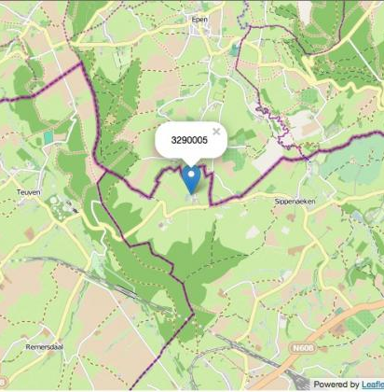
Technologies Used
Core programming language for data handling, API integration, and application logic.
Python:
Framework for building the web-based, real-time dashboard.
Allows rapid deployment of interactive user interfaces with minimal code.
Streamlit:
streamlit
Used for creating interactive global maps.
Displays disaster locations using marker clustering for better visualization.
Folium:

Slide 6



Technologies Used
Provide interactive visualizations like histograms for disaster trends analysis.
Allows dynamic zooming, filtering, and tooltips for better data interpretation.
Plotly:
Handles data structuring, cleaning, and tabular display.
Facilitates easy manipulation of earthquake, wildfire, and storm data.
Pandas:
Handles HTTP requests to external APIs for fetching real-time data.
Ensures reliable communication with multiple data sources.
Requests:

Slide 7
System Architecture
[ User Accesses Streamlit App ]
↓
[ Fetch Data from APIs ]
├──> USGS API (Earthquake Data)
├──> NASA EONET API (Wildfire, Storm Data)
└──> NewsAPI.org (Disaster-related News)
↓
[ Process & Structure the Data ]
├──> Earthquake Details
├──> Wildfire and Storm Events
└──> Latest News Headlines
↓
[ Visualization and Display ]
├──> Interactive Disaster Map (Folium)
├──> Disaster Details Table (Pandas + Streamlit)
├──> Disaster Trend Histograms (Plotly)
└──> Live News Ticker (Streamlit Sidebar)
↓
[ User Interaction ]
├──> Select Disaster Type (Earthquake, Wildfire, Storm, All)
└──> Explore Map, Charts, News in Real-time

Slide 8
Fetching Disaster Data
Functions Developed:
fetch_earthquake_data(): Fetches earthquake details (magnitude, location, time) from USGS API.
fetch_eonet_disasters(): Retrieves disaster event data (title, location, date) for wildfires and storms from NASA EONET API.
fetch_disaster_news(): Collects latest disaster-related news (title, link) from NewsAPI.org.
Key Data Retrieved:
Earthquakes: Magnitude, location, time
Wildfires/Storms: Event title, location, date
News: Headlines and URLs for real-time disaster news

Slide 9
Interactive Map Visualization
Global Disaster Locations: Displays disaster events like earthquakes, wildfires, and storms on an interactive map.
Earthquake Markers (Red): Earthquake locations are marked with red icons for easy identification.
Wildfire/Storm Markers (Blue): Wildfire and storm events are marked with blue icons for differentiation.
Disaster Type Filter: The sidebar filter allows users to select specific disaster types (e.g., Earthquake, Wildfire, Storm) for customized map views.
Marker Clustering: Clusters multiple markers in densely affected areas to prevent overcrowding and improve map readability.

Slide 10
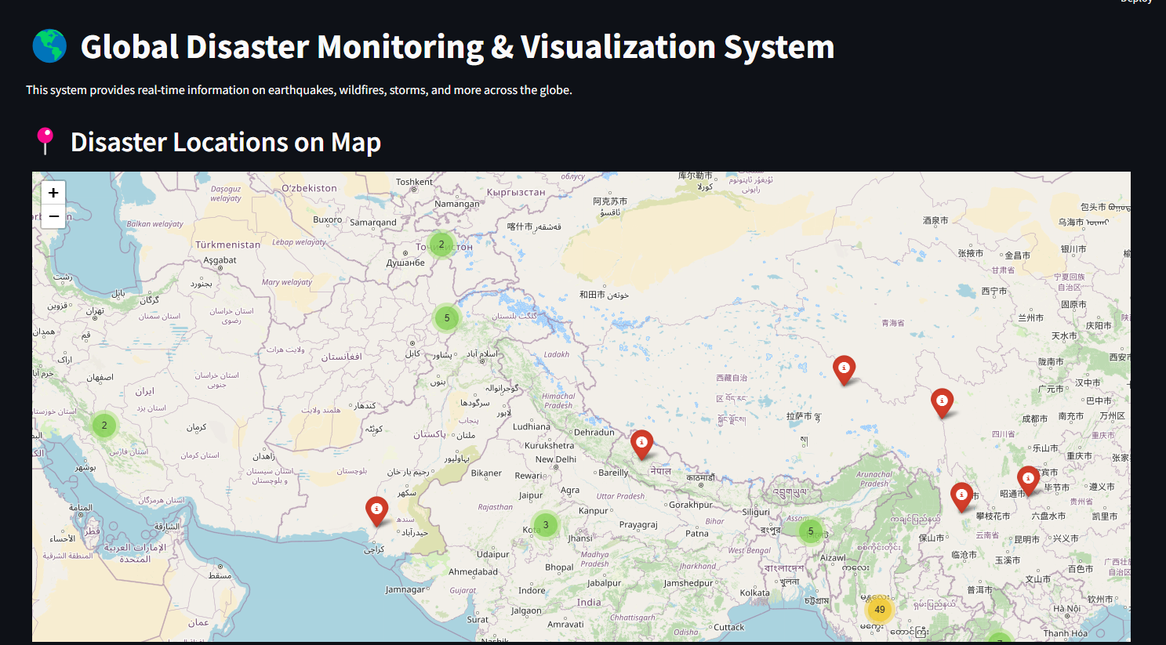

Slide 11
Real-time Disaster Table
Table Displays:
Disaster Type: Type of the disaster (Earthquake, Wildfire, Storm).
Location: Geographic coordinates or place of the event.
Magnitude/Title: Magnitude for earthquakes, title for wildfires/storms.
Date & Time: Exact occurrence time of the disaster.
Technology: Utilizes Streamlit's dataframe component for a clean, interactive display.
Benefit: Provides a quick overview of active disaster events in real-time.

Slide 12
